Slide 2
TOPIC INCLUDES:
Introduction to Thread
Creation of Thread
Life cycle of Thread
Stopping and Blocking a Thread
Using Thread Methods

Slide 3
INTRODUCTION TO THREAD
Process and Thread are two basic units of Java program execution.
Process: A process is a self contained execution environment and it can be seen as a program or application.
Thread: It can be called lightweight process
Thread requires less resources to create and exists in the
process
Thread shares the process resources

Slide 4
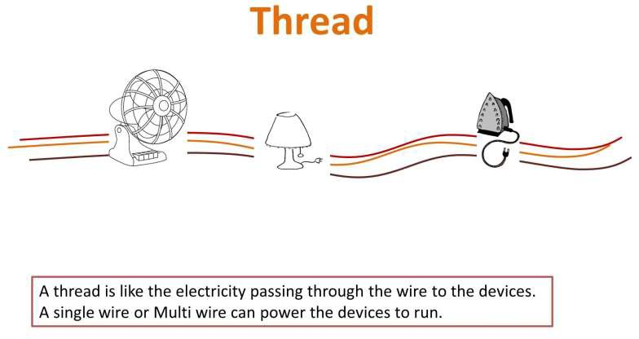
INTRODUCTION Contd.

Slide 5
MULTITHREADING
Multithreading in java is a process of executing multiple processes simultaneously
A program is divided into two or more subprograms, which can be implemented at the same time in parallel.
Multiprocessing and multithreading, both are used to achieve multitasking.

Slide 6
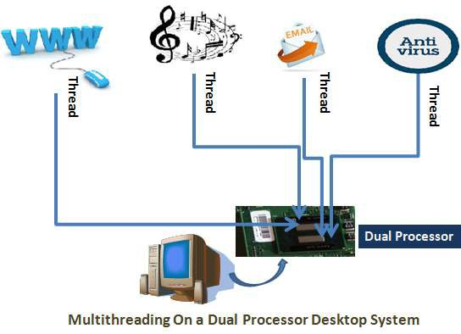
MULTITHREADING Contd.

Slide 7
MULTITHREADING Contd.
ADVANTAGE:
It doesn't block the user
can perform many operations together so it saves time.
Threads are independent so it doesn't affect other threads

Slide 8
CREATING THREAD
Threads are implemented in the form of objects.
The run() and start() are two inbuilt methods which helps to thread implementation
The run() method is the heart and soul of any thread
– It makes up the entire body of a thread
The run() method can be initiating with the help of start() method.

Slide 9
CREATING THREAD Contd.
CREATING THREAD
By extending Thread class

Slide 10
CREATING THREAD Contd.
1. By Extending Thread class
class Multi extends Thread
{
public void run()
{
System.out.println("thread is running...");
}
public static void main(String args[])
{
Multi t1=new Multi(); t1.start();
}
}
Output: thread is running…
// Extending thread class
// run() method declared
//object initiated
// run() method called through start()

Slide 11
LIFE cycle of a thread
During the life time of a thread, there are many states it can enter.
They include:
Newborn state
Runnable state
Running state
Blocked state
Dead state

Slide 12
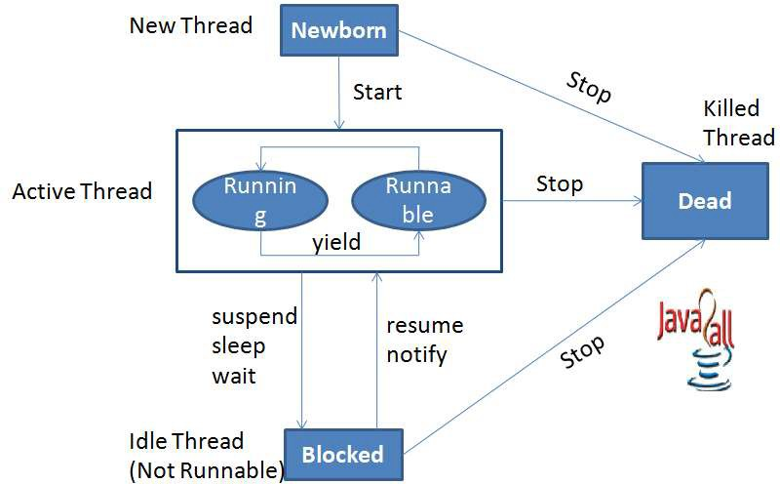
LIFE cycle of a thread contd.

Slide 13
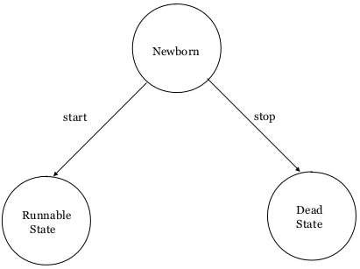
LIFE cycle of a thread contd.
Newborn State:
The thread is born and is said to be in newborn state.
The thread is not yet scheduled for running.
At this state, we can do only one of the following:
Schedule it for running using start() method.
Kill it using stop() method.

Slide 14
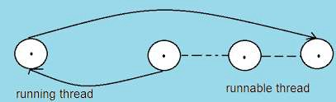
LIFE cycle of a thread contd.
Runnable State:
The thread is ready for execution
Waiting for the availability of the processor.
The thread has joined the queue

Slide 15
LIFE cycle of a thread contd.
Running State:
Thread is executing
The processor has given its time to the thread for its execution.
The thread runs until it gives up control on its own or taken over by other threads.

Slide 16
LIFE cycle of a thread contd.
Blocked State:
A thread is said to be blocked
It is prevented to entering into the runnable and the running state.
This happens when the thread is suspended, sleeping, or waiting in order to satisfy certain requirements.
A blocked thread is considered "not runnable" but not dead and therefore fully qualified to run again.
This state is achieved when we
Invoke suspend() or sleep() or wait() methods.

Slide 17
LIFE cycle of a thread contd.
Dead State:
Every thread has a life cycle.
A running thread ends its life when it has completed executing its run( ) method. It is a natural death.
A thread can be killed in born, or in running, or even in "not runnable" (blocked) condition.
It is called premature death.
This state is achieved when we invoke stop() method or the thread completes it execution.

Slide 18
Thread methods
Thread is a class found in java.lang package.
Method Signature | Description
String getName() | Retrieves the name of running thread in the current context in String format
void start() | This method will start a new thread of execution by calling run() method of Thread/runnable object.
void run() | This method is the entry point of the thread. Execution of thread starts from this method.
void sleep(int sleeptime) | This method suspend the thread for mentioned time duration in argument (sleeptime in ms)
void yield() | By invoking this method the current thread pause its execution temporarily and allow other threads to execute.
void join() | This method used to queue up a thread in execution. Once called on thread, current thread will wait till calling thread completes its execution
boolean isAlive() | This method will check if thread is alive or dead

Slide 19
THANK YOU…

